Slide 1


Slide 2
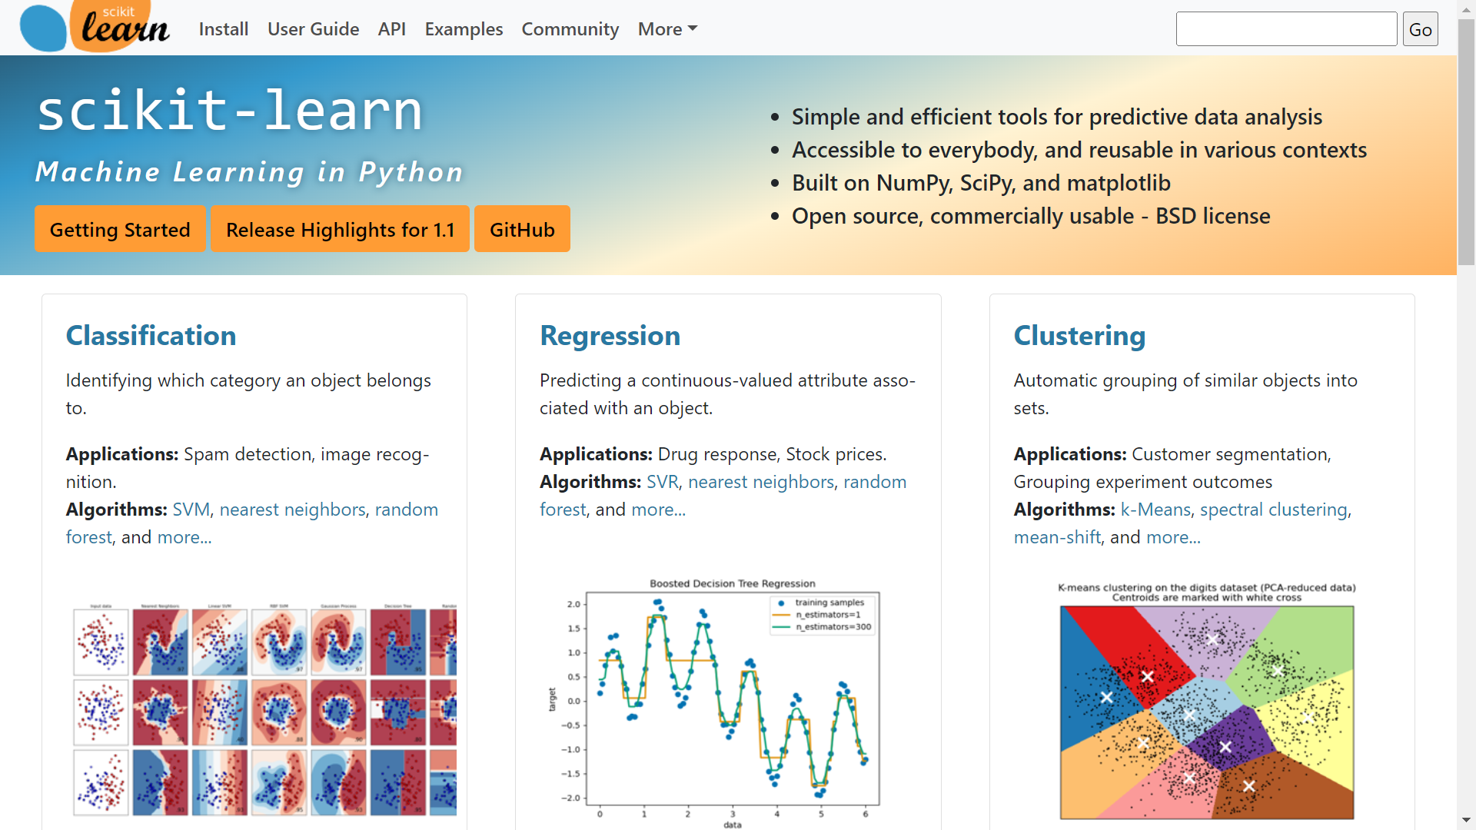

Slide 3
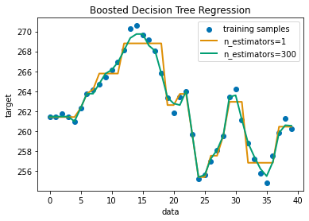
Exercise Adapt Regression demo
sklearn1.py
from sklearn.ensemble import AdaBoostRegressor
from sklearn.tree import DecisionTreeRegressor regr_1 = DecisionTreeRegressor(max_depth=4) regr_2 = AdaBoostRegressor(
DecisionTreeRegressor(max_depth=4), n_estimators=300, random_state=rng) regr_1.fit(X, y)
regr_2.fit(X, y) y_1 = regr_1.predict(X)
y_2 = regr_2.predict(X)
https://scikit-learn.org/stable/auto_examples/ensemble/plot_adaboost_regression.html

Slide 4
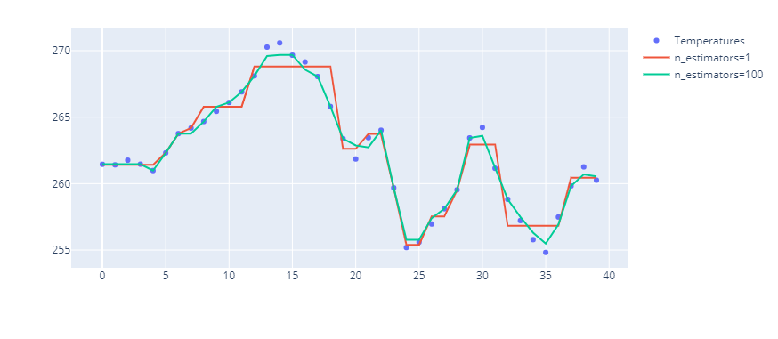
Plotly
sklearn2.py
import plotly.graph_objects as go
fig = go.Figure()
fig.add_trace(go.Scatter(y=y,
mode='markers',
name='Temperatures'))
fig.add_trace(go.Scatter(y=y_1,
mode='lines',
name='n_estimators=1'))
fig.add_trace(go.Scatter(y=y_2,
mode='lines',
name='n_estimators=100'))
Notes:
replace Matplotlib by Plotly
- https://plotly.com/python/plotly-express/
- https://plotly.com/python/px-arguments/
- https://plotly.com/python/line-and-scatter/#line-and-scatter-plots

Slide 5

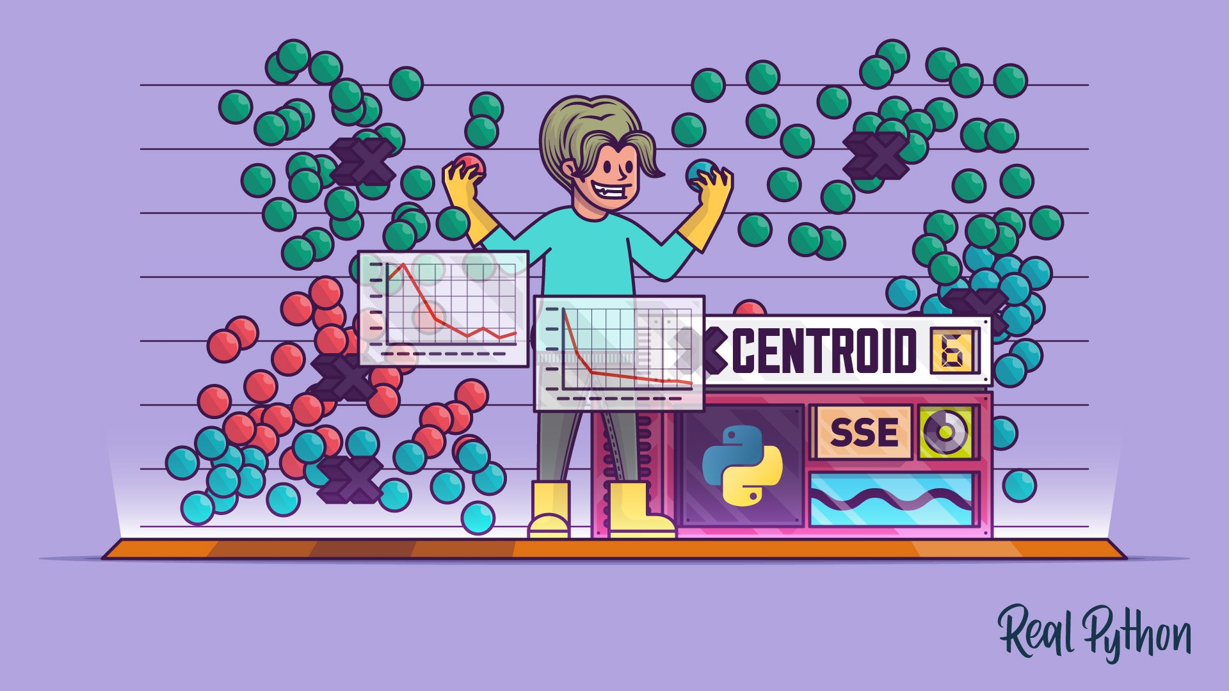
More resources Tutorials
https://realpython.com/linear-regression-in-python/
https://realpython.com/k-means-clustering-python/

Slide 6
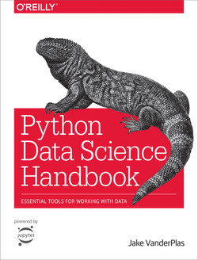
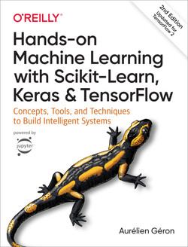
More resources Books
https://jakevdp.github.io/PythonDataScienceHandbook/

Slide 7
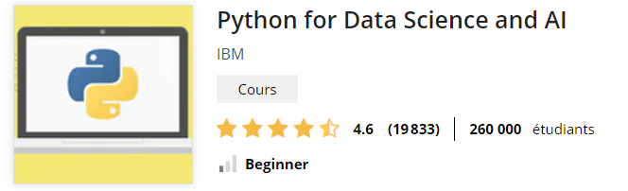
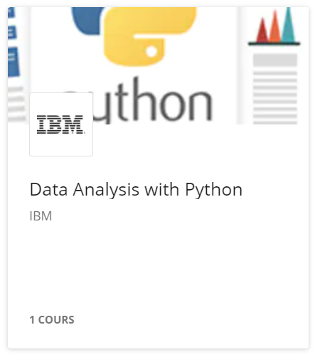
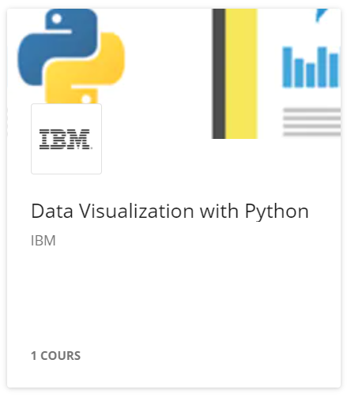
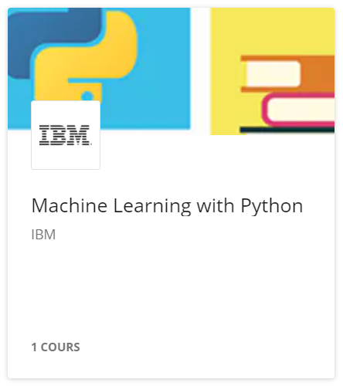
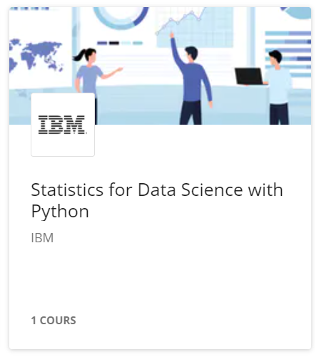
More resources Online Courses

